Slide 1
Undirected Graph Analysis
Hasib ar rafiul Fahim-2019-1-60-036
Eftekharul Islam Sinha-2019-1-60-051
Fayjul islam nahid-2019-1-60-027

Slide 2
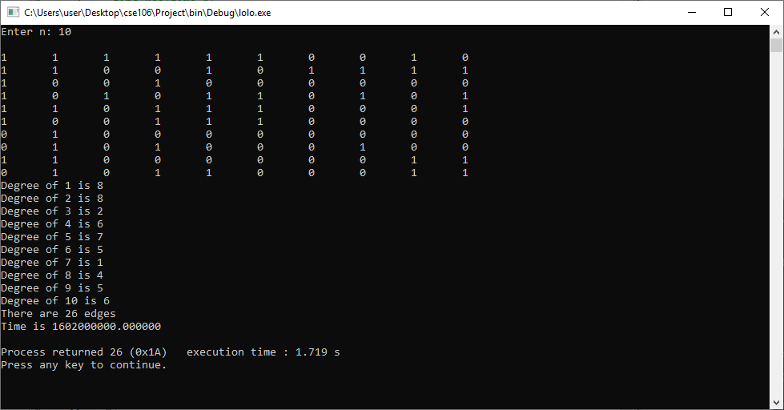
Undirected Graph:
A graph that has edges without any direction is called
undirected graph.
This is an adjacency matrix having n=10 viewed in a Code blocks compiler

Slide 3
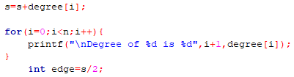

Finding Number of Edges:
To find the number of edges, at first the degrees of each vertex has to be determined.
Then, the number of edges (e) can be determined with the help of the handshaking formula:
$$\text{2}\text{e}\text{=}\sum_{∈}{\text{deg}\text{(}\text{v}\text{) }}$$
Here, we see that the sum of degrees of each vertex was found by iterative addition.
Then, the number of edges was determined by dividing the sum by 2.

Slide 4
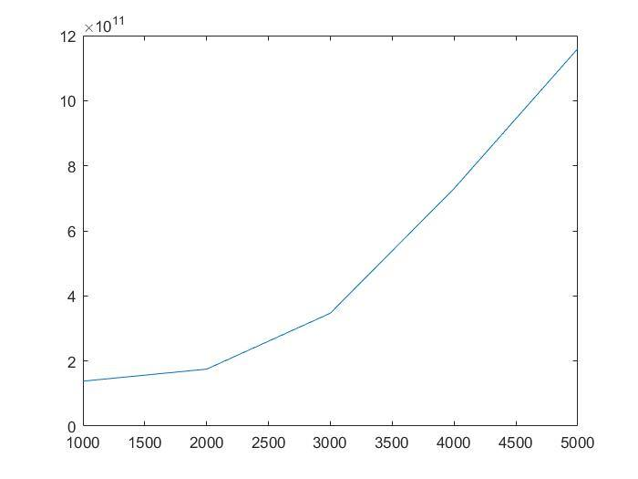
Computation Time:
We determine the computation time in ns for n=1000 with the help of clock() function in C.
The process is repeated for n=2000, n=3000, n=4000 and n=5000.
And the computation time vs n graph is drawn by plotting the values of computation time that we found for different values of n.
This is the graph that was plotted with the help of MATLAB.

Slide 5
According to the graph, we can say that:
f(n) = 4.6×10⁴×n² = θ(n²)
So, the function f(n)=θ(n²) is the approximate time complexity.

Slide 6
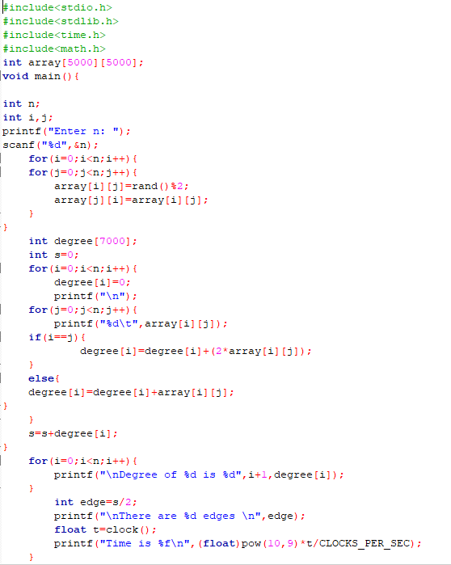

Theoretical Complexity:
From the code we can see that there are 3 loops
in the program.
Loop-1 takes place $\frac{n(n+1)}{2}$ times.
Loop-2 takes place (n+1)(n+1) times.
And, Loop-3 takes place (n+1) times
So, Average-case complexity
= $\frac{n(n+1)}{2}$ + (n+1)(n+1) + (n+1)
= 1.5n² + 1.5n + 2 = θ(n²)
If we calculate it in ns then it becomes:
10⁶(1.5n² + 1.5n + 2)
Which is equal to θ(n²)
So, the practical complexity that we got from the graph
approximately corresponds to the Theoretical complexity.

